Slide 1
Washington’s portal to state and federal clean energy funds
Introducing FundHub.WA.gov — centralized, personalized access to climate and clean energy funding opportunities
September 2024

Slide 2
A once-in-a-generation opportunity
More funding than ever before for projects relating to energy efficiency, clean energy, and climate resiliency.
New grants, incentives, and tax credits — for all types of people and orgs — emerging from both federal laws (IRA, BIL, CHIPS) and the Washington state Climate Commitment Act (CCA).
Accessibility challenges make it hard to find out about funding. Washingtonians don’t know what funding they’re eligible for; organizational grant seekers must manually search, sort, and vet opportunities on their own.
A funding hub for Washington was born in 2024, when the Legislature directed the Department of Commerce to use CCA funds to create a centralized web portal for state and federal funding related to climate, clean energy, and clean technology.

Slide 3
Introducing FundHubWA
The searchable database at FundHub.WA.gov delivers relevant funding opportunities in just three clicks
Enter who you are and the type of funding you’re interested in to get personalized results
Filter by grant type, amount, application requirements and more
VISIT FUNDHUB.WA.GOV

Slide 4
Funding opportunities for:
Individuals
Businesses
Education
Local Government
Nonprofits
Public Agencies
Tribes
Utilities

Slide 5
What you'll find on FundHubWA
Searchable database of funding opportunities for tribes, public agencies, nonprofit, and businesses
Links to applications and resources to help you apply for grants, rebates, and other incentives
Email signups to keep you in the loop about upcoming opportunities that are right for you
News and Resources section shows how funding gets utilized and promotes support resources for funding seekers
Notes:
Searchable database of funding opportunities for tribes, public agencies, nonprofit, and businesses
Links to applications and resources to help you apply for grants, rebates, and other incentives
Email signups to keep you in the loop about upcoming opportunities that are right for you

Slide 6
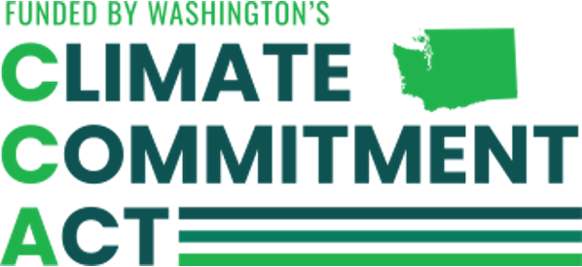
Funded by the Climate Commitment Act
FundHubWA is supported with funding from Washington’s Climate Commitment Act. The CCA supports Washington’s climate action efforts by putting cap-and-invest dollars to work reducing climate pollution, creating jobs, and improving public health. Information about the CCA is available at www.climate.wa.gov.

Slide 7
Get Involved
Have relevant funding opportunities to add to FundHubWA? Fill out this form to get started.
Contact Becky Thomas for marketing and communications support: bthomas@cplusc.com
Contact Amy Wheeless for general questions about FundHubWA, funding opportunities, and state process: amy.wheeless@commerce.wa.gov

Slide 8
Thank you!

